Slide 1


Slide 2
Uninstall unused USB PPC Ethernet Card

Slide 3
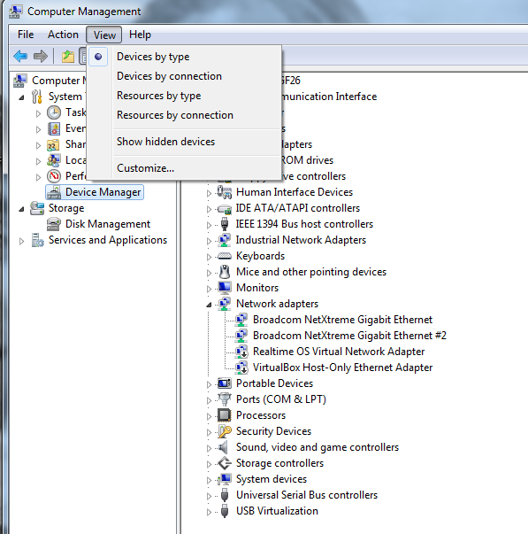
Unused STM32F4 USB Ethernet
If UAC is enabled, then run this as Administrator
Click Start, click Run, type cmd.exe, and then press ENTER.
Type "set devmgr_show_nonpresent_devices=1", and then press ENTER.
Type Start DEVMGMT.MSC, and then press ENTER.
Click View, and then click Show Hidden Devices.
Expand the Network Adapters tree.
Right-click the dimmed network adapter, and then click Uninstall.
Click on View
Show hidden devices

Slide 4
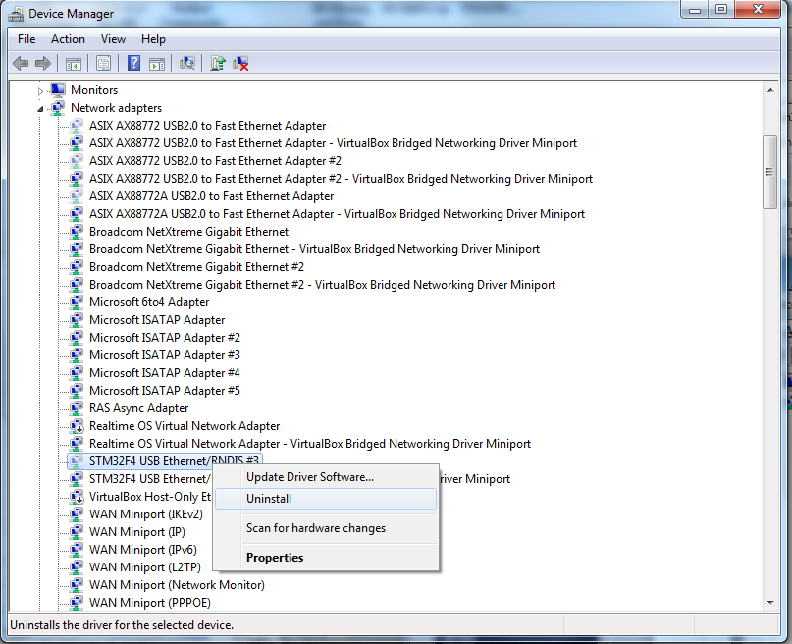
Uninstalled unused STM32F4 USB Ethernet
Click on Network adapters
Find STM32F4 USB Ethernet/RNDIS #
Right-Click
Uninstall

